Slide 1
Digital Material – UDL project
Presentation - http://tinyurl.com/hw5knt5
Backchannel - http://tinyurl.com/zb6de5x
Record questions, comments, discussion points
during or after presentation

Slide 2

Enriching Practice:
Supporting Diversity through Universal Design for Learning
AQPC 2016
Roberta Thomson
Project Coordinator –
UDL-Faculty/Toolkit
Course Instructor
Susie Wileman
Coordinator, Psychologist
Student AccessAbility Centre
Dawson College
Brenda Rowe
UDL Pedagogical Consultant
John Abbott College
Notes:
Roberta

Slide 3
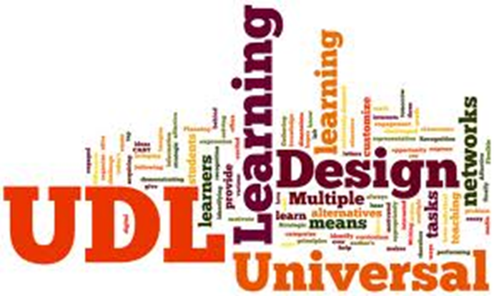

Learning Objectives
Understand
  Context of UDL and the Chantier 3 Project
  Common themes from participants
Discover
  Facilitators and Stressors derived from Faculty
  Wish list for a UDL Toolkit
Reflect
  On facilitators and stressors in your own practice
@UDLChantier3

Slide 4
UD to UDL
From Universal Design (UD)
To Universal Design for Learning (UDL)
UD
Structural Environments
UDL
UDI
UID
Learning Environments
@UDLChantier3

Slide 5
Paradigm Shift
Person
As Problem
Medical Model
Person-focused, individual problem,
fixed/cured by ‘experts’.
Social Model
Society/Environment-focused, shift to disabling
factors in society and the environment.
Disability is created when individuals face barriers
upon interaction with elements of any environment.
Environment
As Problem
@UDLChantier3

Slide 6








Chantier 3 Project Context
Three-year collaboration December 2013
Project Goals:
Identify facilitators & stressors of faculty’s perception and use of UDL.
Creation of an online, accessible, user-friendly, bilingual toolkit to support faculty in their implementation of the UDL framework.
Follow us on Twitter @UDLChantier3

Slide 7
Project Partners
SCHOOL | TYPE | NUMBERS | PROGRAMS
Centennial | College - private | 100 | Day school Pre-U
Dawson | College - public | 10,000 | Day school/ Eve. Pre-U, Professional
John Abbott | College - public | 9,700 | Day school/ Eve. Pre-U, Professional
Marianopolis | College - private | 1,900 | Day school Pre-U
McGill | University | 39,500 | Undergraduate, Graduate, Postgrad
CRISPESH | College and University | Province of Quebec | Research Post-Secondary Students with Disabilities
@UDLChantier3

Slide 8
Why UDL? Why Now?
Evolution students with disabilities in post-secondary Quebec (Comité Interordres, 2013)
Sensory, Motor, ADHD, LD, ASD,
Year Neurological Mental Health Total
2007-2008 600 400 1000
2008-2009 800 1500 3000
2009-2010 900 2000 3000
2010-2011 1100 3800 4000
2011-2012 1200 4300 5500
2012-2013 1700 5500 7200
@UDLChantier3
Notes:
Sensory… still rising, but not as fast as ADHD LD, ASD and Mental Health

Slide 9
Partner Paths
McGill MyAccess 2011 - Growth in students with disability
  Movement towards UDL from office and beyond
Centennial College 2010 - Medical Model practices
  Switch to sustainable practices via social model and UDL
Dawson College 1995 - Increasing numbers and UD
  2010 French department faculty, FLC on UDL
John Abbott College 2013 - UDL Pedagogical Consultant
  Establishment of UDL Advisory team with early champions
Marianopolis College 2013 – UDL Awareness
  Collaboration of Access Office, Pedagogical and French department
Start of Chantier 3 Faculty/Toolkit Project Dec 2013

Slide 10
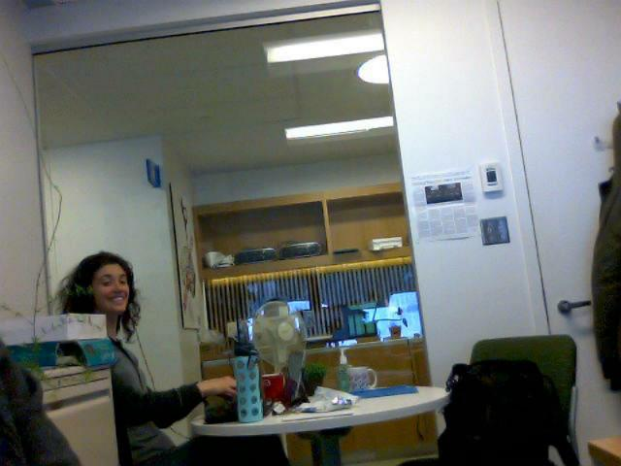
Materials and Methodology
Study design (Early 2014)
  Ethics approval & Semi-structured interviews
Selection of participants (Spring/Fall 2014)
Data collection (2014)
  77 semi-structured interviews across 5 institutions
  Transcribed manually - 2 research assistants
Data analysis – Coding (Spring/Summer 2015)
  Qualitative/Quantitative analysis 2 research assistants
  Development of emerging and common themes
  Identification of facilitators and stressors
Development of Accessible Web /Toolkit (2015-2016)
  Open Concept Web developer
NOW
@UDLChantier3

Slide 11

Interviews
Focus of the questions:
Philosophy of responding to diversity
Social justice in education
Concrete pedagogical practices
UDL and 3 Principles
Facilitators and Stressors
Policies – Institutional/Provincial
.
Partner | Participants
Centennial | 10
Dawson | 16
John Abbott | 18
Marianopolis | 12
McGill | 21
TOTAL | 77
@UDLChantier3

Slide 12

Data Analysis
Two research coding assistants over ten weeks
Extracting
Coding for Stressors, Facilitators, Toolkit, UDL questions:
    Categories
    Tallies
    Percentages
Teachers’ use of UDL principles
    By principle
    By discipline
    With CBAM
Fairness
Policy
@UDLChantier3

Slide 13
Concerns Based Adoption Model CBAM
(Hall & Hord, 2001)
Understanding teachers possible concerns
related to an innovative
Me!
  Awareness – not concerned about it
  Informational – know more about it
  Personal – effect on me and the changes that I need to make
It!
  Management – time for preparation
  Consequence – effect on learners, how to refine for potential impact
Us!
  Collaboration – relate my work with others work
  Refocusing – ideas to improve innovation
http://www.sedl.org/cbam/cbam-916.jpg

Slide 14
Concerns Based Adoption Model (CBAM)
All interviewees were aligned with one or more level
Level Key Concern Totals
0 Personal Awareness 9% 10 interviewees
1 Personal Informational 29% 31 interviewees
2 Personal Effect on me 4% 4 interviewees
3 Innovation UDL Management 23% 25 interviewees
4 Innovation Consequence 12% 13 interviewees
5 Us Collaboration 14% 15 interviewees
6 Us Refocusing of innovation 9% 10 interviewees
@UDLChantier3
Notes:
The main concerns focused around level 1 which is what are the details of UDL, I need to know more . Level 3 looks at the Management of it’s use. How to find time to do it.

Slide 15

Demographics
FULL SAMPLE: 77 Teachers
Gender Female 51
Male 24
Gender Queer 1
N/A 1
Age Average 45
Median 45
Years teaching Average 13
Years at Institution Average 9
Course Load Full-time 60
Part-time 14
Unknown 3
@UDLChantier3
Notes:
Median – half the numbers are lower and half higher.

Slide 16
Departments Sampled - 36
Teachers
9 English
8 Humanities
7 French
4 Chemistry, Math
3 Biology, Nursing, Phys Ed.
2 Dental Hygiene, Educational Psychology, Continuing Studies – (Project Management, Spanish, EAP), Liberal Arts, Library, Medicine/Pathology, Sociology,
1 Computer Science, Industrial Design, Fine Arts, North/South, CRLT, Political Science, Psychology, Photography, Social Science/Ethics, Religious Studies, Business, Information & Library Technology, Publication Design/Hypermedia, Visual Arts, Illustration & Design, Education, History, Occupational Therapy, Bio-resource Engineering.

Slide 17

Main Themes
Desire For
  Knowledge
    About UDL and Pedagogy
    Variability of students
  Training
    Post-Secondary pedagogy
    Professional Development
  Support System
    Communities of Practice/Faculty Learning Communities
    Institutional Support
  Technology
    Information and Communication Technologies
    Assistive Technologies

Slide 18

Implementing UDL
Facilitators
69% Support System
  45% Teachers’ Community
  43% School Support
64% Knowledge
  56% Practical UDL
  31% Diversity of learners
40% Training
  31% Professional Development
39% Environment
  25% Student/teacher Interactions
38% Technology
  31% Better/More ICTs
24% Flexibility
Your thoughts?
@UDLChantier3

Slide 19
Facilitators
Support System
Teachers’ Community:
Feedback from teachers
Team work
Exchanges with colleagues
Discussion of ideas with others
Faculty Learning Community
School Support:
Better / More resources / Access centers
Help in designing material
@UDLChantier3

Slide 20
Facilitators
Knowledge
Practical UDL:
Examples
Concrete ways to implement UDL
Diversity:
Learning about different disabilities / learning styles /diversity
Knowing needs of students
Training
Professional Development:
Workshops
PED days
@UDLChantier3

Slide 21

Implementing UDL
Stressors
55% Management (time)
45% Preparation
35% Implementation
49% Lack of Knowledge
34% Diversity of learners
22% Practical UDL
44% Institutional Barriers
34% Administrative
26% Environmental (space)
42% Engagement
38% Teacher’s perception of student engagement
14% Teacher related engagement with aspects UDL
26% Technology
19% Lack of ICTs
10% Lack of Assistive Technologies
Your thoughts?
@UDLChantier3

Slide 22
Stressors
Management
Preparation:
“It’s more work”
“Time to plan it”
“Ultimately time, time, time, that’s my biggest
restriction”
Implementation:
“Time to pull it off in class”
“No time to do UDL”
@UDLChantier3

Slide 23
Stressors
Lack of Knowledge
Diversity:
Different needs
Different disabilities
Different learning styles
Practical knowledge of UDL:
“How do I implement UDL?”
“What does it mean? How do I apply it concretely?”
Engagement
Perception of Student Engagement:
Students’ workload
Trouble engaging students
Keeping students focused
External distractions
@UDLChantier3

Slide 24

Main Findings: Toolkit

Slide 25
Main Findings: Toolkit
Toolkit (Website)
52% Examples
48% Guidelines
39% Knowledge about UDL
29% Technology
23% Collaboration/Peer Support
18% Discipline/Interdisciplinary Tools
10% Website Layout
Your thoughts?
@UDLChantier3

Slide 26
Toolkit
Examples
Lesson plans
Examples of other teachers using UDL material
Activities/Games/Case studies
Rubrics
Guidelines
Templates/Checklist/Matrix so teachers can use 3
principles
Instructional/UDL Strategies
Classroom management/organization techniques
Checklists - to show teachers’ % of UDL implementation
@UDLChantier3

Slide 27

Myths within Data on UDL
UDL is only for students with disabilities
You must use technology
Lowers Attendance and academic integrity
Some disciplines are inherently UDL
Doesn’t prepare students for the ‘real’ world
With UDL can’t reliably assess students
Active learning is the same as UDL
You can implement UDL through a checklist
@UDLChantier3

Slide 28
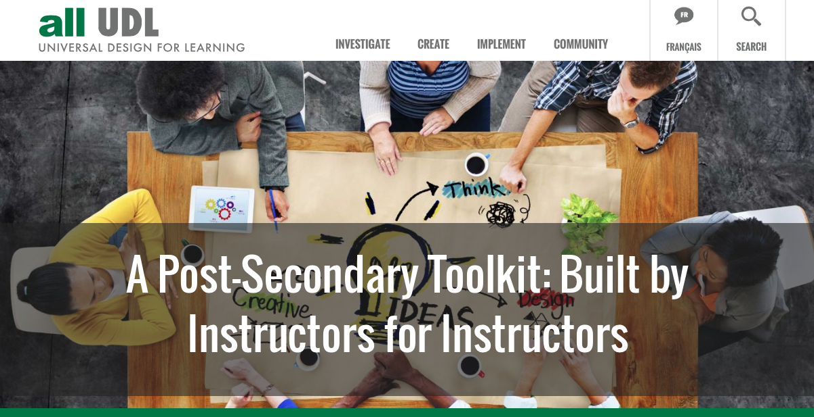
Interview-based Website Design
@UDLChantier3

Slide 29
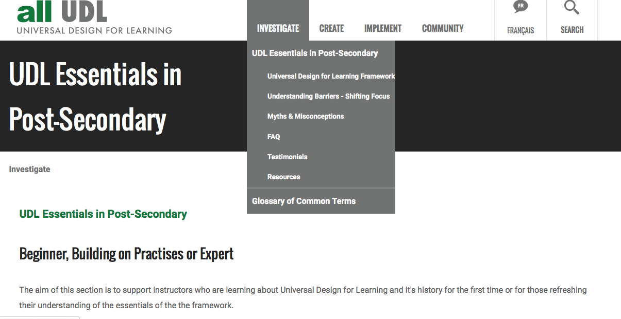
Investigate
@UDLChantier3

Slide 30
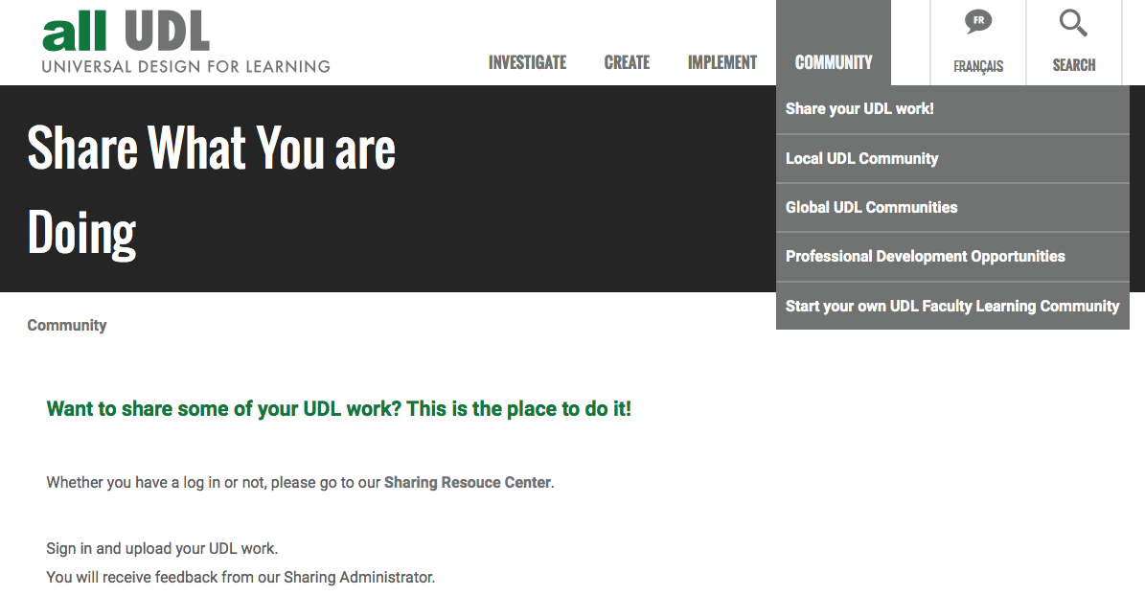
Sharing Resource Center
@UDLChantier3

Slide 31

Questions
Susie Wileman
swileman@dawsoncollege.qc.ca
Coordinator, Psychologist
Student AccessAbility Centre
Dawson College
Instructor – Concordia University
Brenda Rowe Roberta Thomson
brenda.rowe@johnabbott.qc.ca
UDL Pedagogical Consultant
John Abbott College
Instructor – Concordia University
Roberta Thomson
roberta.thomson2@mcgill.ca
Project Coordinator –
Chantier 3 UDL Faculty/Toolkit
Course Instructor –
LaSalle College/McGill University
@UDLChantier3

